Slide 1
FEARFUL SYMMETRIES:
Cosmic Order as Evidence of God
Institute Day
Holy Family High School
Broomfield CO, Feb 13, 2020

Slide 2
“For from the greatness and beauty of created things comes a corresponding perception of their Creator.” (Wisdom 13:1-5)
“Ever since the creation of the world [God’s] eternal power and divine nature, invisible though they are, have been understood and seen through the things he has made.” (Romans 1:20)
“Creation itself reveals him who created it; and the work made is itself suggestive of him that made it; and the world manifests him that arranged it.” --- St. Irenaeus ca 180 AD

Slide 3
St. Irenaeus, ca 180 AD:
“There exists but one God … He is the Father, God, the Creator, the Author, the giver of order.”
Minucius Felix, ca 200 AD:
“… when you see providence, order, and law in the heavens and on earth, believe that there is a Lord and Author of the universe, more beautiful than the stars themselves and the various parts of the whole world.”
Origen, ca 250 AD:
“… when we are convinced by what we see in the excellent orderliness of the world, then we worship its Maker as the one Author of one effect, which --- since it is entirely in harmony with itself --- cannot, therefore, have been the work of many makers.”

Slide 4
Lactantius, ca 300 AD:
“There is no one so uncivilized nor of such barbarous manners that he does not, when he raises his eyes to heaven, … understand something from the very magnitude of things, their motion, arrangement, constancy, beauty and proportion, and that this could not possibly be if it were not established in wonderful order, having been fashioned on some greater design.”
St. Athanasius, early 4th century:
“… creation, as if in written characters and by means of its order and harmony, declares in a loud voice its own Master and Creator.”
“God, by his own Word, gave to creation such order as is found therein, so that though he is by nature invisible, men might be able to know him through his works.”

Slide 5
St. Gregory of Nazianzus, late fourth century,:
“Let us [even] suppose that the existence of the world is spontaneous. To what will you ascribe its order?”
St. Gregory of Nyssa, late 4th century:
“… all creation --- and above all, as the Scripture says, the orderly arrangement of the heavens --- demonstrates the wisdom of the Creator through the skill displayed in his works.”
St. Cyril of Alexandria, mid-fifth century:
“… from the origination of the world [and] from its order and beauty … we can recognize that the wisdom and power of him who created [it] and brought [it] into existence far surpasses every [created] mind.”

Slide 6
“ID movement” argument:
Things not explicable naturally
Examples from Biology
Complexity of Structure
More traditional “Argument from Order”:
Nature itself
All of Nature, Entire Cosmos
Order, Beauty, Harmony, Lawfulness

Slide 7


Slide 8
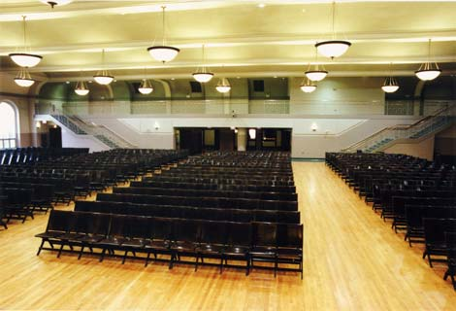

Slide 9
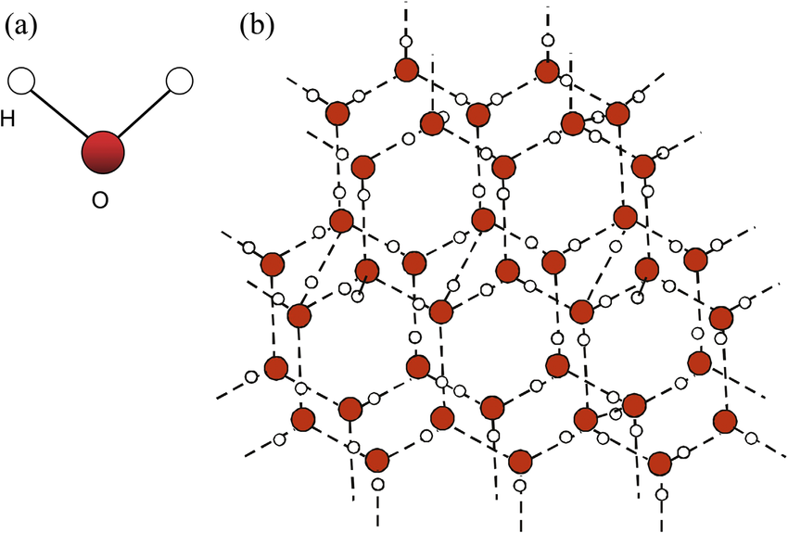

Slide 10
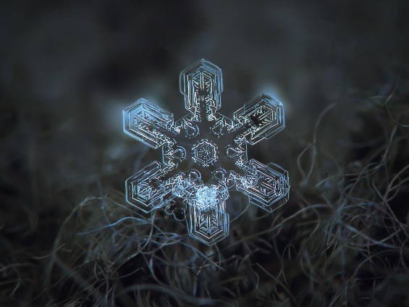

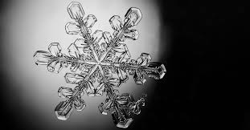
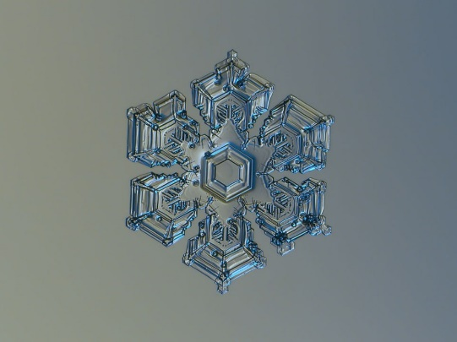

Slide 12
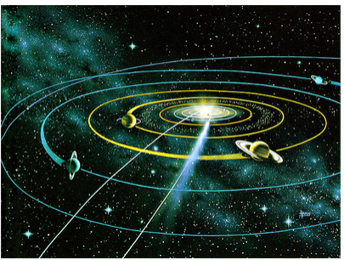

Slide 13
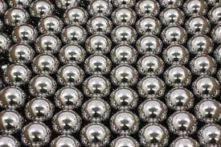

Slide 14
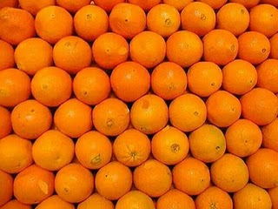


Slide 16
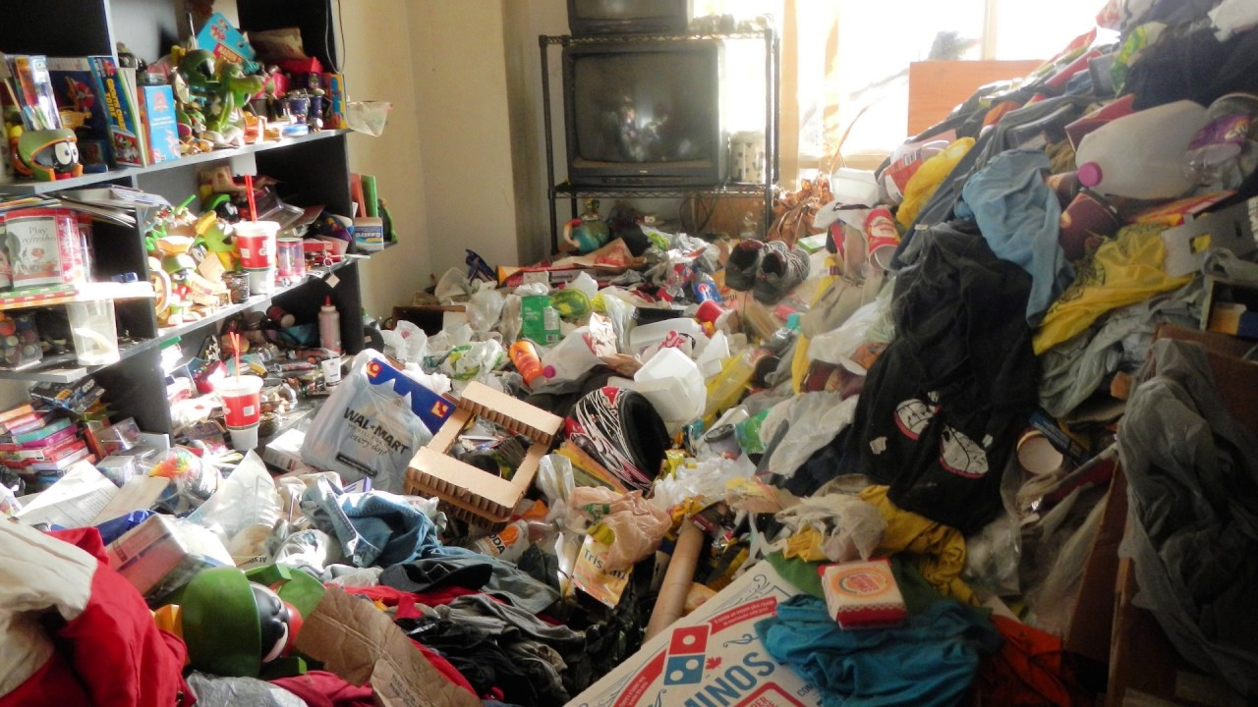

Slide 17


Slide 18
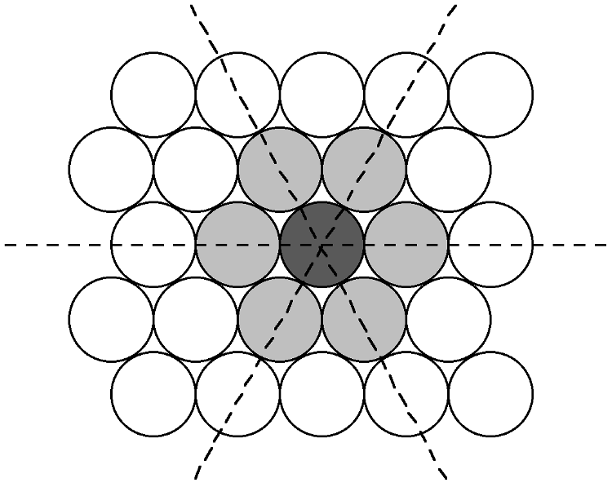

Slide 19
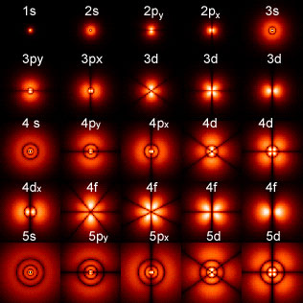
States of the hydrogen atom (electron probability distributions)
Atoms are highly symmetric structures.

Slide 20
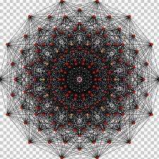
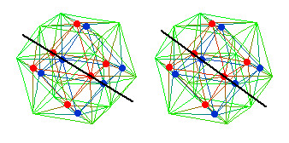

Slide 21
“Fundamental physicists are sustained by the faith that the Ultimate Design is suffused with symmetries.
“Contemporary physics would not have been possible without symmetries to guide us. … Learning from Einstein, physicists [look for] symmetries and see that a unified conception of the physical world may be possible. They hear symmetries whispered in their ears. As physics moves further away from everyday experience and closer to the mind of the Ultimate Designer, our minds are trained away from their familiar moorings.
“The point to appreciate is that contemporary theories, such as grand unification or superstring, have such rich and intricate mathematical structures that physicists must marshal the full force of symmetry to construct them. They cannot be dreamed up out of the blue. Nor can they be constructed by laboriously fitting one experimental fact after another. These theories are dictated by Symmetry.” --- Anthony Zee

